Slide 1

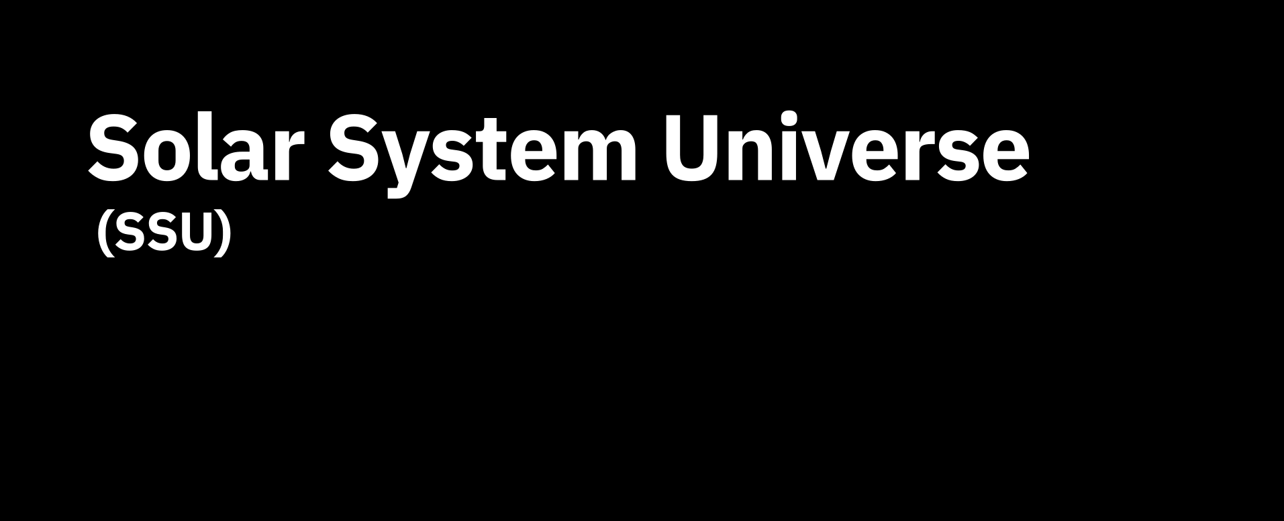






Slide 2























Slide 3





Slide 4





Slide 5



Slide 6



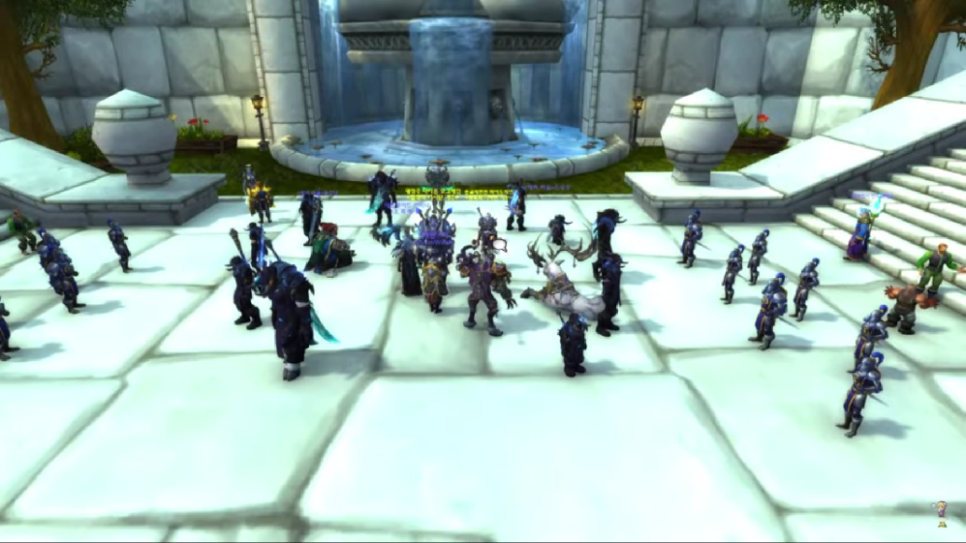


Slide 7

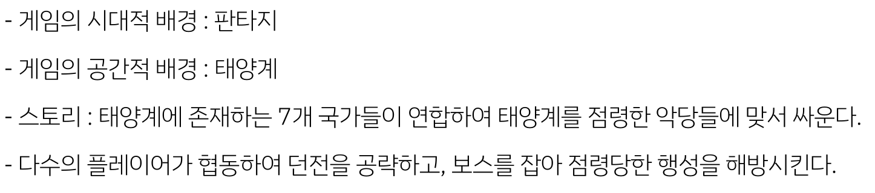

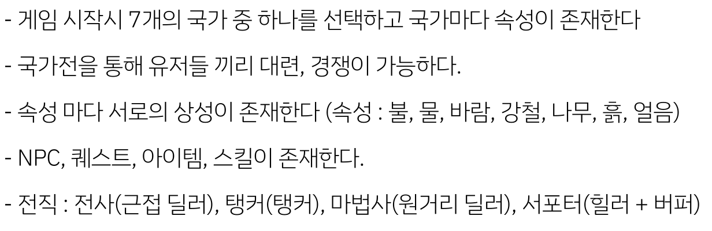

Slide 8
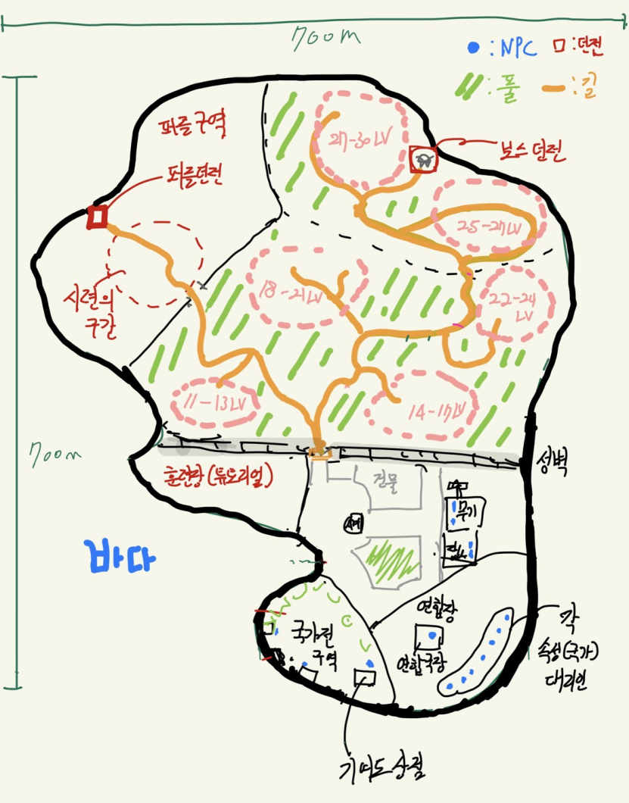

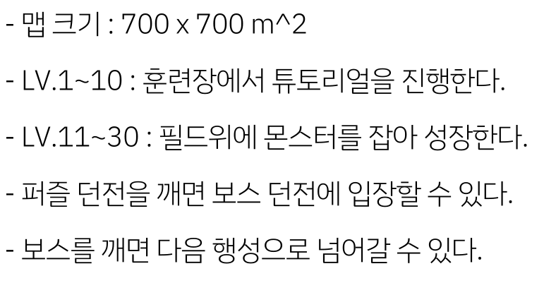

Slide 9



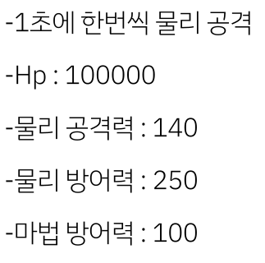
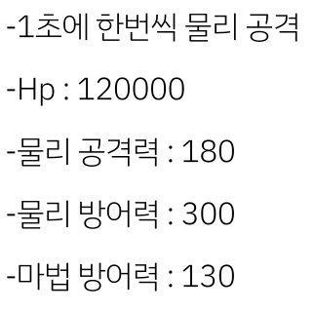


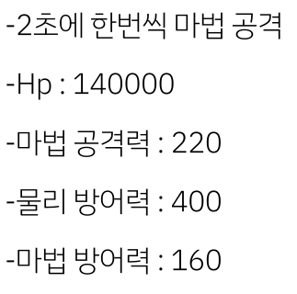
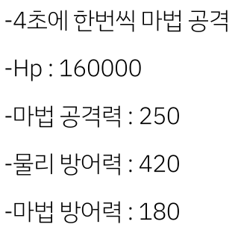

Slide 10


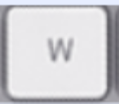


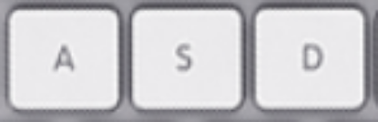





Slide 11



Slide 12
















Slide 13



Slide 14






Slide 15



Slide 16
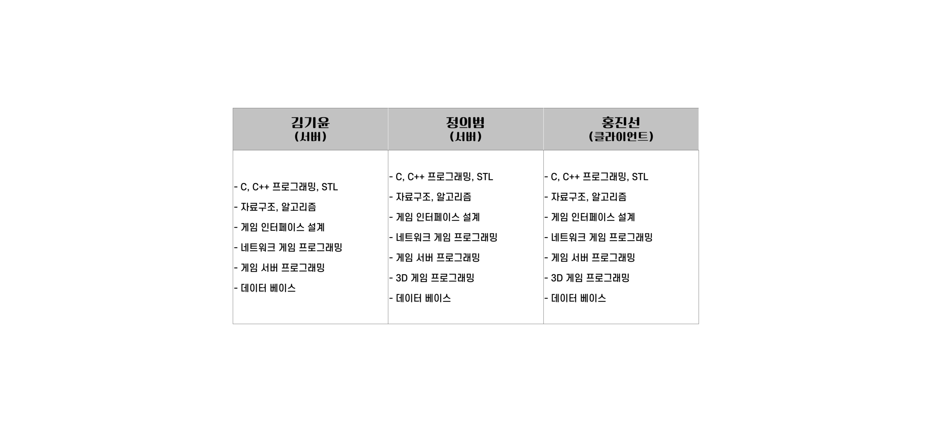


Slide 17



Slide 18

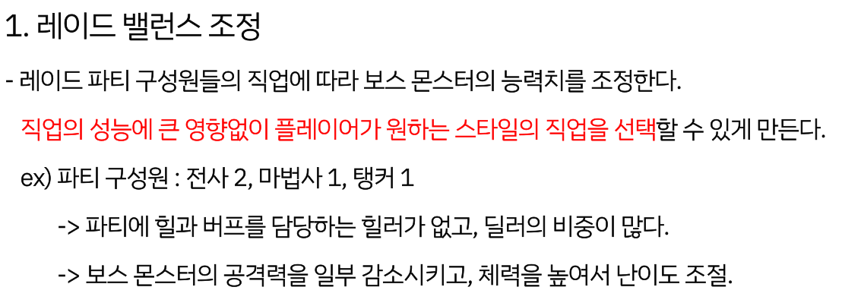
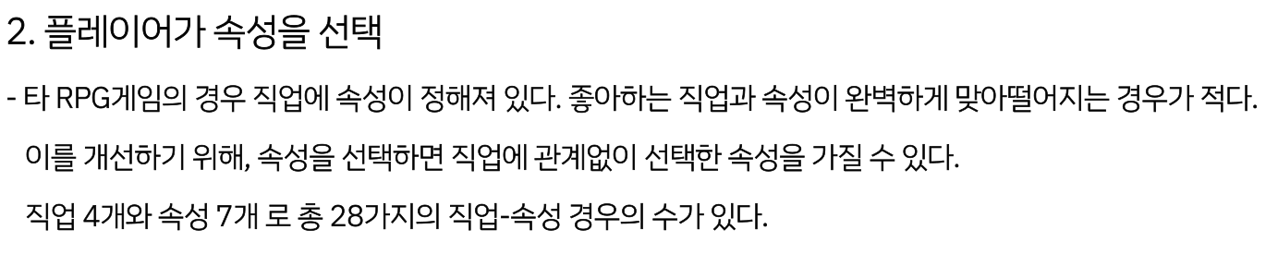

Slide 19
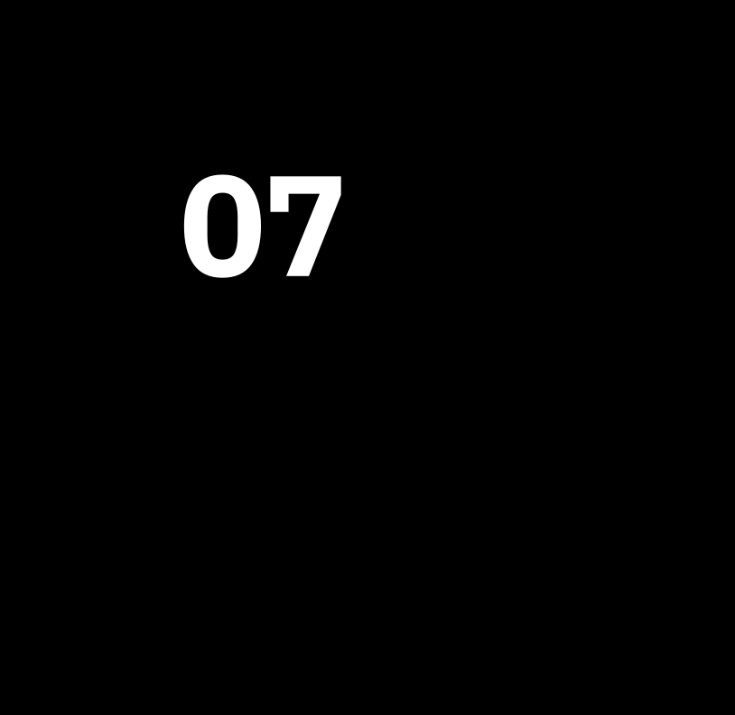


Slide 20

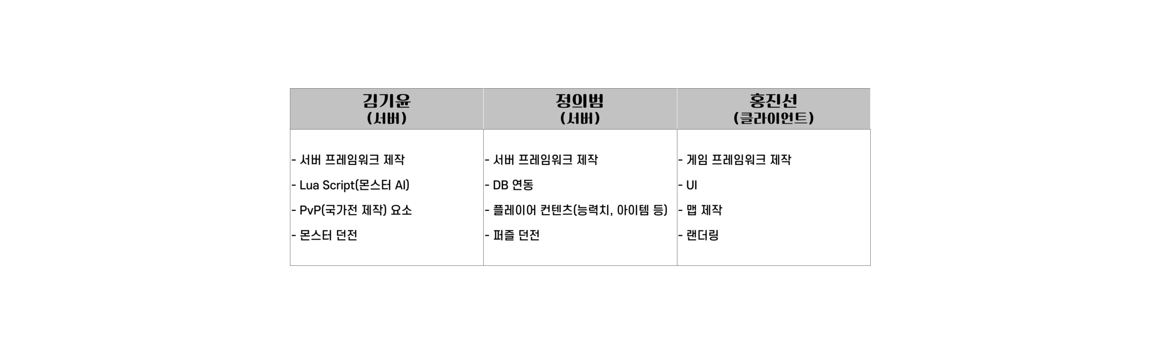

Slide 21

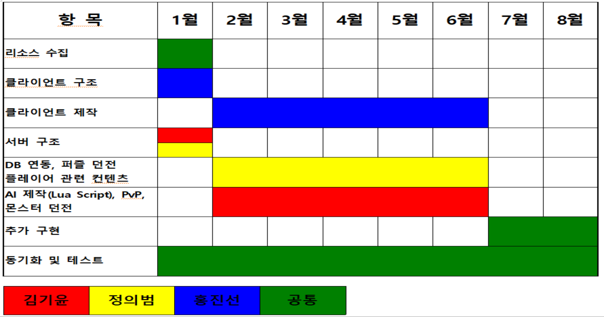

Slide 22



Slide 23

(게임소개 p.6)
와우 스크린샷 : https://www.youtube.com/watch?v=aMNdM2FaJdE
(개발환경 p.11)
비쥬얼 스튜디오 : https://m.blog.naver.com/document0330/221971560457
깃 : https://ko.wikipedia.org/wiki/%EA%B9%83_(%EC%86%8C%ED%94%84%ED%8A%B8%EC%9B%A8%EC%96%B4)
깃포크 : https://git-fork.com/
Direct X : https://www.bodnara.co.kr/bbs/article.html?num=119107
MS SQL : https://m.blog.naver.com/chsmanager/220528359282
SSMS : https://www.esoftner.com/database/sql-server-management-studio-download/
Unity : https://www.google.com/url?sa=i&url=https%3A%2F%2Funity.com%2Fkr&psig=AOvVaw0v6MEQ5wcmOboawPVWVnEZ&ust=1639202842700000&source=images&cd=vfe&ved=0CAsQjRxqFwoTCIigoM3I2PQCFQAAAAAdAAAAABAD
LUA : https://ko.wikipedia.org/wiki/%EB%A3%A8%EC%95%84_(%ED%94%84%EB%A1%9C%EA%B7%B8%EB%9E%98%EB%B0%8D_%EC%96%B8%EC%96%B4)
그 외 이미지는 직접 제작

